Slide 1
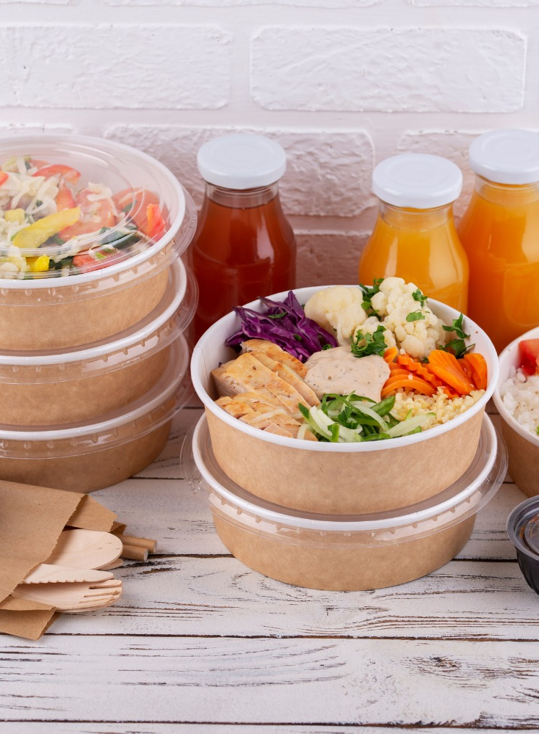
Food & Beverage Industry
M&A and Valuation Insights
April 2024
www.peakstone.com

Slide 2
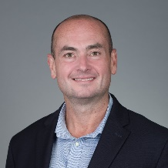
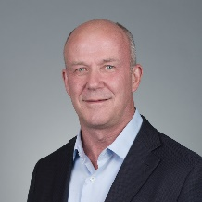
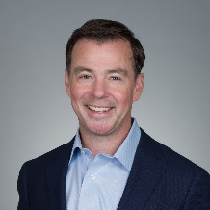
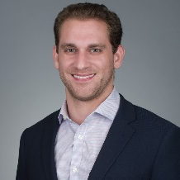
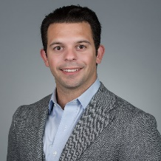
Overview
2008
Year Founded
500+
Transactions by Peakstone MDs
$200+ Billion
Capital Raised by Peakstone MDs
25+ Years
Average Years of Peakstone
MD Experience
40+
Investment Banking Professionals
18+
Industries Covered
$10 - $500 Million
Client Revenue Profile
30+ Countries
Global Reach
Selected Transactions
M&A Advisor
M&A Advisor
M&A Advisor
M&A Advisor
M&A Advisor
M&A Advisor
Private Investment Group
M&A Advisor
M&A Advisor
M&A Advisor
M&A Advisor
M&A Advisor
M&A Advisor
Contact Information
Alex Fridman – Managing Partner
(312) 346-7303
afridman@peakstone.com
Stephen Sleigh – Managing Partner
(312) 346-7318
ssleigh@peakstone.com
Jeff Temple – Managing Partner
(312) 346-7301
jtemple@peakstone.com
Noah Robles – Associate
(305) 494-2035
nrobles@peakstone.com
Michael Dobin – Analyst
(847) 609-9492
mdobin@peakstone.com

Slide 3
U.S. M&A Activity
Food & Beverage M&A Count Across the U.S. (2000 – Mar 2024)
217
24
41
229
60
186
42
10
15
204
142
414
39
24
76
178
67
195
226
65
21
47
56
200
47
135
338
91
11
53
19
225
1,270
82
105
10
69
30
59
35
81
129
28
60
130
38
358
45
19
338
50
11
2
U.S. Food & Beverage M&A Count (2000 – Mar 2024)
(#)
Source: Capital IQ
Note: As of March 31, 2024

Slide 4
Transaction Analysis
Median Transaction Value (2000 – Mar 2024)
($ in millions)
Median EV Multiples (2000 – Mar 2024)
Source: Capital IQ
Note: 2022, 2023, and 2024 EV/EBITDA are shown as the average of the preceding years due to the presence of outliers;
As of March 31, 2024

Slide 5
Trading Analysis
Relative Stock Performance (2013 – Mar 2024)
S&P 500: 231%
Retail: 152%
Beverage: 109%
Ingredients: 96%
Production: 27%
EV/EBITDA Trend (2013 – Mar 2024)
Beverage: 17.9x
Ingredients: 15.5x
S&P 500: 16.6x
Production: 10.3x
Retail: 6.0x
Key
Peakstone Food Ingredients Index (“Ingredients”)
Peakstone Beverage Products Index (“Beverage”)
Peakstone Food Retail Index (“Retail”)
Peakstone Food Production Index (“Production”)
S&P 500
Peakstone Food Ingredient Index: DD, IFF, CE, BCPC, SXT
Peakstone Beverage Products Index: KO, PEP, MNST, STZ, BF.B, TAP, FIZZ, FARM, LWAY
Peakstone Food Retail Index: WMT, COST, DG, KR, ACI, SFM, WMK, IMKT.A, SPTN, VLGE.A, NGVC
Peakstone Beverage Products Index: MDLZ, KHC, GIS, TSN, HSY, HRL, MKC, K, CAG, SJM, CPB, PPC, POST, FLO, HAIN, JJSF, THS, UTZ, FDP
Source: Capital IQ
Note: As of March 31, 2024

Slide 6
Selected Transactions
Date | Target | Buyer | Deal Size ($mm) | Target Description | Transaction Comments
Mar-2024 | SunOpta (Açaí and Smoothie Bowl Business) | Sambazon | $6 | Açaí and Smoothie Bowl Business of SunOpta sells frozen Açaí and Smoothie bowls | Sambazon acquired Açaí and Smoothie Bowl Business of SunOpta from SunOpta for approximately $6 million on March 8, 2024
Feb-2024 | Progressive Produce Corporation | PTF Holdings | $120 | Progressive Produce Corporation grows, packs, distributes, and ships fresh produce | PTF Holdings agreed to acquire 65% stake in Progressive Produce Corporation from Dole for approximately $120 million on February 27, 2024
Feb-2024 | Benson Hill Ingredients | White River Soy Processing | $72 | Benson Hill Ingredients engages in the production and sale of ingredients for food, feed, and cooking oils | White River Soy Processing acquired Benson Hill Ingredients from Benson Hill for approximately $72 million on February 13, 2024
Feb-2024 | Devenish Nutrition | Easy Bio | $66 | Devenish Nutrition develops and manufactures premixes, pre-starters, starters, and concentrates | Easy Bio USA agreed to acquire Devenish Nutrition from Devenish Nutrition Limited for $66 million on February 7, 2024
Jan-2024 | Utz Quality Foods (Certain assets and brands) | Our Home | $183 | Certain assets and brands of Utz Quality Foods comprises three snacks manufacturing facilities and Good Health and R.W. Garcia brands | Our Home entered into a definitive agreement to acquire Certain assets and brands of Utz Quality Foods for approximately $183 million on January 31, 2024
Jan-2024 | Ingomar Packing Company | Kagome | $243 | Ingomar Packing Company produces, and packages tomato paste | Kagome acquired 50% stake in Ingomar Packing Company for approximately $243 million on January 26, 2024
Jan-2024 | Calavo Growers (Fresh Cut Business) | F&S Fresh Foods | $100 | Fresh Cut Business of Calavo Growers sells prepped fresh-cut fruit and vegetables | F&S Fresh Foods signed a non-binding letter of intent to acquire Fresh Cut business of Calavo Growers for approximately $100 million on January 16, 2024
Dec-2023 | La Colombe Torrefaction | Chobani | $900 | La Colombe Torrefaction produces packaged coffee and operates coffee shops | Chobani acquired La Colombe Torrefaction from Keurig Dr Pepper and others for $900 million on December 15, 2023
Nov-2023 | Sonoma-Cutrer Vineyards | The Duckhorn Portfolio | $391 | Sonoma-Cutrer Vineyards manufactures and distributes Chardonnay | The Duckhorn Portfolio entered into a definitive agreement to acquire Sonoma-Cutrer Vineyards from Brown-Forman Corporation for approximately $391 million on November 16, 2023
Source: Capital IQ
Note: Selected transactions have transaction value greater than $5 million

